Slide 1
Chapter 3
INTEREST FORMULAS AND THEIR APPLICATIONS

Slide 2
INTEREST FORMULAS AND THEIR APPLICATIONS
Interest rate is the rental value of money. It represents the growth of capital per unit period.
The period may be a month, a quarter, semiannual or a year.
An interest rate 15% compounded annually means that for every hundred rupees invested now, an amount of Rs. 15 will be added to the account at the end of the first year.
So, the total amount at the end of the first year will be Rs. 115.

Slide 3
TIME VALUE OF MONEY
If an investor invests a sum of Rs. 100 in a fixed deposit for five years with an interest rate of 15% compounded annually, the accumulated amount at the end of every year will be as shown in the table

Slide 4
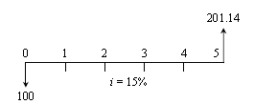
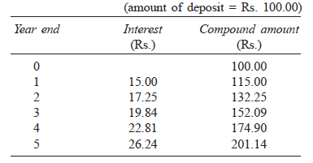
Compound Amount
F = P(1 + i)^{n}

Slide 5

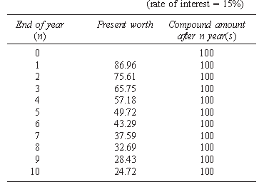

Present worth

Slide 6
The formula to find the future worth in the third column is:
F = P(1 + i)^{n}
where
P = principal amount invested at time 0,
F = future amount,
i = interest rate compounded annually,
n = period of deposit.

Slide 7
INTEREST FORMULAS
Interest rate can be classified into:
Simple interest rate and
Compound interest rate.
In simple interest, the interest is calculated, based on the initial deposit for every interest period. In this case, calculation of interest on interest is not applicable.
In compound interest, the interest for the current period is computed based on the amount (principal plus interest up to the end of the previous period) at the beginning of the current period.

Slide 8
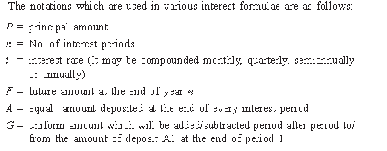

Slide 9
Single-Payment Compound Amount
Here, the objective is to find the single future sum (F) of the initial payment (P)
made at time 0 after n periods at an interest rate i compounded every period.
The formula to obtain the single-payment compound amount is
F = P(1 + i)^{n} = P(F/P, i, n)
where
(F/P, i, n) is called as single-payment compound amount factor.

Slide 10
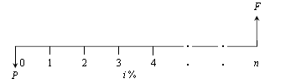

Slide 11
Example
A person deposits a sum of Rs. 20,000 at the interest rate of 18% compounded annually for 10 years. Find the maturity value after 10 years.

Slide 12

Single-Payment Present Worth Amount
Here, the objective is to find the present worth amount (P) of a single future sum (F) which will be received after n periods at an interest rate of i compounded at the end of every interest period.
The formula to obtain the present worth is
P = F/(1 + i)^{n}
= F(P/F, i, n)

Slide 13
Example
A person wishes to have a future sum of Rs. 1,00,000 for his son’s education after 10 years from now. What is the single-payment that he should deposit now so that he gets the desired amount after 10 years? The bank gives 15% interest rate compounded annually.

Slide 14

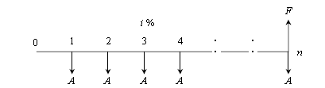
Equal-Payment Series Compound Amount
In this type of investment mode, the objective is to find the future worth of n equal payments which are made at the end of every interest period till the end of the nth interest period at an interest rate of i compounded at the end of each interest period.
The formula to get F is

Slide 15
Example
A person who is now 35 years old is planning for his retired life. He plans to invest an equal sum of Rs. 10,000 at the end of every year for the next 25 years starting from the end of the next year. The bank gives 20% interest rate, compounded annually. Find the maturity value of his account when he is 60 years old.

Slide 16

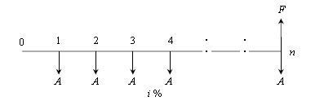
Equal-Payment Series Sinking Fund
In this type of investment mode, the objective is to find the equivalent amount (A) that should be deposited at the end of every interest period for n interest periods to realize a future sum (F) at the end of the nth interest period at an interest rate of i.
The formula to get F is

Slide 17
Example
A company has to replace a present facility after 15 years at an outlay of Rs. 5,00,000. It plans to deposit an equal amount at the end of every year for the next 15 years at an interest rate of 18% compounded annually. Find the equivalent amount that must be deposited at the end of every year for the next 15 years.

Slide 18


Examples

Slide 19


Examples

Slide 20
Equal-Payment Series Present Worth Amount
The objective of this mode of investment is to find the present worth of an equal payment made at the end of every interest period for n interest periods at an interest rate of i compounded at the end of every interest period.

Slide 21


Slide 22
Example
A company wants to set up a reserve which will help the company to have an annual equivalent amount of Rs. 10,00,000 for the next 20 years towards its employees welfare measures. The reserve is assumed to grow at the rate of 15% annually. Find the single-payment that must be made now as the reserve amount.

Slide 23
Equal-Payment Series Capital Recovery Amount
The objective of this mode of investment is to find the annual equivalent amount (A) which is to be recovered at the end of every interest period for n interest periods for a loan (P) which is sanctioned now at an interest rate of i compounded at the end of every interest period

Slide 24


Slide 25
EXAMPLE
A bank gives a loan to a company to purchase an equipment worth Rs. 10,00,000 at an interest rate of 18% compounded annually. This amount should be repaid in 15 yearly equal installments. Find the installment amount that the company has to pay to the bank.

Slide 26
Uniform Gradient Series Annual Equivalent Amount
The objective of this mode of investment is to find the annual equivalent amount of a series with an amount A1 at the end of the first year and with an equal increment (G) at the end of each of the following n – 1 years with an interest rate i compounded annually.

Slide 27
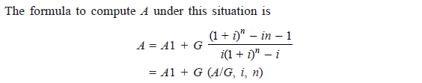

Slide 28
Example
A person is planning for his retired life. He has 10 more years of service. He would like to deposit 20% of his salary, which is Rs. 4,000, at the end of the first year, and thereafter he wishes to deposit the amount with an annual increase of Rs. 500 for the next 9 years with an interest rate of 15%. Find the total amount at the end of the 10th year of the above series.

Slide 29
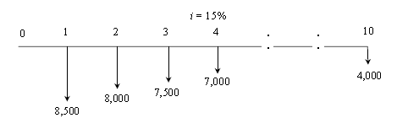
Example
A person is planning for his retired life. He has 10 more years of service. He would like to deposit Rs. 8,500 at the end of the first year and thereafter he wishes to deposit the amount with an annual decrease of Rs. 500 for the next 9 years with an interest rate of 15%. Find the total amount at the end of the 10th year of the above series.

Slide 30


Slide 31
Effective Interest Rate
Let i be the nominal interest rate compounded annually. But, in practice, the compounding may occur less than a year. For example, compounding may be monthly, quarterly, or semi-annually. Compounding monthly means that the interest is computed at the end of every month. There are 12 interest periods in a year if the interest is compounded monthly. Under such situations, the formula to compute the effective interest rate, which is compounded annually, is
Effective interest rate,
where, i = the nominal interest rate C = the number of interest periods in a year.

Slide 32
EXAMPLE
A person invests a sum of Rs. 5,000 in a bank at a nominal interest rate of 12% for 10 years. The compounding is quarterly. Find the maturity amount of the deposit after 10 years.

Slide 33
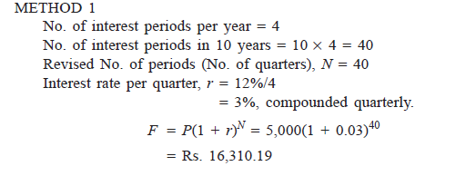

Slide 34
